Slide 1

Soil & Plant Amendment Registration
Raj Mann, Ph.D. | Pesticide Non-point Section Manager
Pesticide & Fertilizer Management Division

Slide 2



Fertilizer and Soil/Plant Amendment Program
Products fall into one of three categories
Image of plants growing in fields
Agricultural Fertilizer
I
Specialty Fertilizer
Soil/Plant Amendment

Slide 3
Statute & Rules
Statute Chapter 18 C: Fertilizer, Soil Amendment, and Plant Amendment Law
MN Administrative Rules Chapter 1510
Minn. Stat. §18C.411
Specialty fertilizers and soil/plant amendments must be registered with MDA to be sold and distributed in the state
Minn. Rule §1510.0432
Product labels must meet statutory requirements
*Requirements address claims made on labels
Association of American Plant Food Control Officials (AAPFCO) provides guidance to maintain uniformity among states.

Slide 4
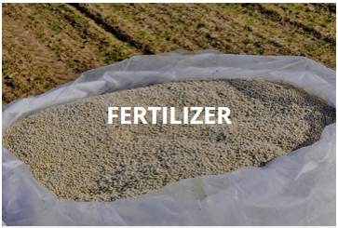
Fertilizer
Definition:
“Fertilizer” means a substance containing one or more recognized plant nutrients that is used for its plant nutrient content and designed for use or claimed to have value in promoting plant growth. Fertilizer does not include animal and vegetable manures that are not manipulated, marl, lime, limestone, and other products exempted by rule by the commissioner.

Slide 5
Specialty Fertilizer
Definition:
"Specialty fertilizer" means a fertilizer labeled and distributed for, but​ not limited to, the following uses: greenhouses, nurseries, home gardens, house plants, lawn fertilizer, shrubs,​ golf courses, municipal parks, and cemeteries.

Slide 6
Types of Specialty Fertilizer Products
Primary, secondary or micro-nutrients fertilizers
Primary plant nutrients
NPK compounds
Secondary plant nutrients
Calcium, Magnesium, Sulfur
Micronutrients
Zinc, Copper, Boron, Manganese,
(Not all specialty fertilizer types are listed here)

Slide 7
Soil Amendment
Definition:
"Soil amendment" means a substance intended to improve the structural, physical, or biological characteristics of the soil or modify organic matter at or near the soil surface, except fertilizers, agricultural liming materials, pesticides, and other materials exempted by the commissioner’s rules.

Slide 8

Plant Amendment
Definition:
“Plant Amendment” mean a substance applied to plants or seeds that is intended to improve germination, growth, yield, product quality, reproduction, flavor, or other desirable characteristics of plants except fertilizers, soil amendments, agricultural liming materials, pesticides, and other materials that are exempted by rule.

Slide 9
Soil and Plant Amendments
Soil amendment products and plant amendment products are registered together (same form, same fee)
For registration purposes, there is no need to differentiate

Slide 10
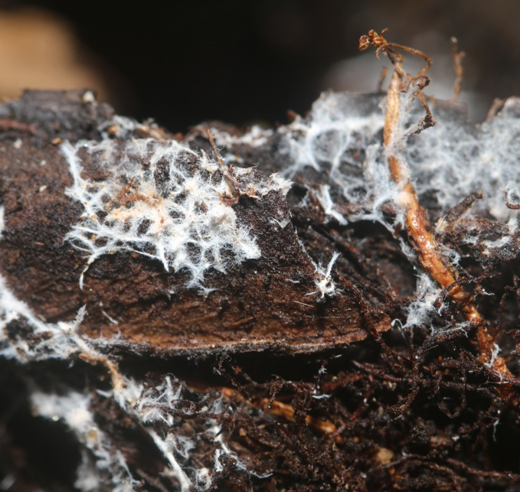
Types of Amendment Products
Microorganisms
Legume inoculants; Bacteria; Mycorrhizal fungi
Organic materials
Compost; Peat/sphagnum; Humic substances
Wetting agents
Surfactants; Polymers and gels; Flocculants
Gypsum
Enzymes
(Not all amendment types are listed here)

Slide 11




Registration Process
Registrant submits application, application fee ($200/product), and product label by mail
Program Administrator reviews label for compliance with Minnesota statute and rules
If in compliance, product is registered unconditionally, and a certificate is sent to the registrant by mail
If not in compliance, product is either denied registration, or it is registered conditionally, and a letter is sent with the certificate detailing required label changes

Slide 12

Amendment Label Requirements
Brand name
Guaranteed analysis
Name and address of guarantor
Net weight
Purpose statement
Directions for use
Claims
Labels are reviewed for claims of benefit
MDA can require a company to submit data to substantiate claims of benefit

Slide 13
Label Claims
If a questionable claim is identified on a product label during the review process…
MDA contacts the registrant to request either
Data be submitted to substantiate the claim, or
The claim statement be revised or removed
MDA reviews the submitted data or revised label to determine if claims are acceptable for registration
* Depending on claims being made and the presence of additional label issues, applications may be held while claims are reviewed, or a conditional registration may be issued

Slide 14
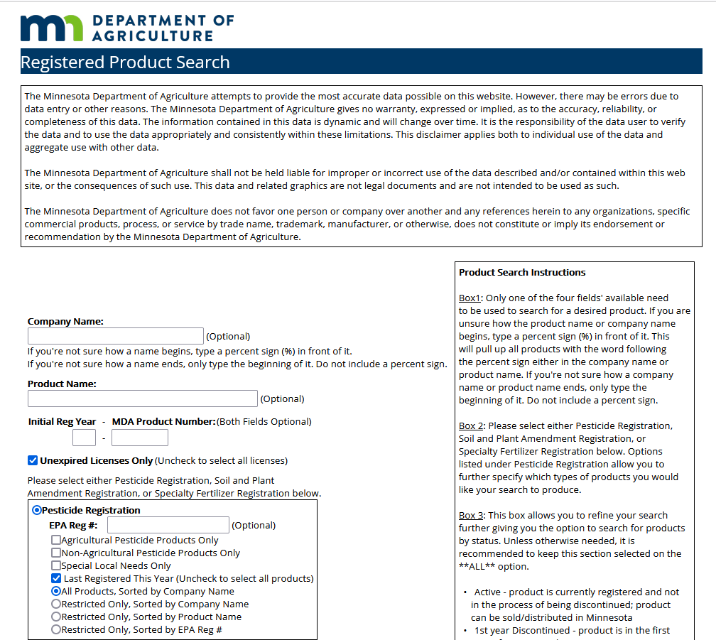
Registration and Tonnage Reporting
Products are registered annually
Tonnage of specialty fertilizers and soil & plant amendments sold must be reported each year
Searchable data base for registered product search http://www2.mda.state.mn.us/webapp/lis/productsdefault.jsp

Slide 15
MDA Soil/Plant Amendment Registration History
Products
Companies

Slide 16
Thank you!
Raj Mann
rajinder.mann@state.mn.us

